Slide 1
Django and Celery

Slide 2
Links
[1] https://stackabuse.com/asynchronous-tasks-in-django-with-redis-and-celery/?__cf_chl_captcha_tk__=0905099b359e9e9d3ccbb17ffd2f706a627b7bf2-1582285181-0-Aflw9ixmixxXPj71p1fgomojEYtXuvssGUzXbhYBj7IlBtg7z9RSyGNHKADOmP_a7WxFpM8YVgEWmo2tmRjMxdQ-7gQknjVCYNfJLZJH3Mfa7FTUAUHPqUsdIj3Mdvo-CYA1BhaMcwHL5BlO9vD_uEWzBgUDe1pp2WV8Y7BMmF1jwi9lY3SQr-mJnG9M2Q03MfYS0Y2rnZBVaYF99a8MYq50vEEo9nKA2sG6xMab3gI2B2BU2m8ZkRFXqsFZDadwhPrEPxQGm1b2_CDhjVRJCbcgqLWKg79ned16Eu4jPWHrErV11cpMEwUht2AeY9vZpcFw-as-rZvI86tQs5KdzniAH776m3jm2F0DVctB8AqG3gsb9FWpzFPB7lINHD2gOVi0cYuG2IowYjfOsu-zoXmC6awpZfFOlK-o8qCYsIc7FdQQqd9TqaLs6AuW-nkt8Q

Slide 3
[2] https://www.codingforentrepreneurs.com/blog/celery-redis-django
In this link, they show tips on how to use celery on heroku
[3] https://stackoverflow.com/questions/49702352/django-celery-beat-task-not-working
[4] https://medium.com/@ksarthak4ever/django-handling-periodic-tasks-with-celery-daaa2a146f14
[5] https://medium.com/the-andela-way/timed-periodic-tasks-in-celery-58c99ecf3f80

Slide 4
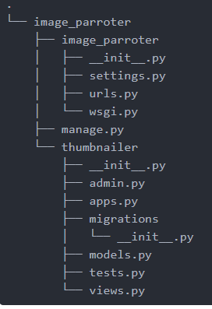
Steps
Installing Redis on SO
Create virtualenv
pip install Django Celery redis
Create a project Django and its apps. In this tutorial, the apps are at in project level.

Slide 5
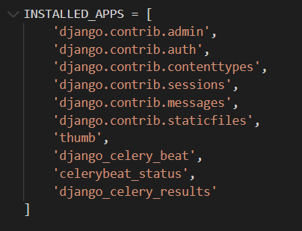
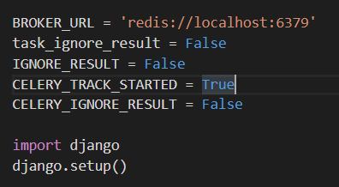
5. Create file celery.py in directory: image_parroter/image_parrroter/celery.py
You may have problems with ‘DJANGO_SETTINGS_MODULE’. If yes, you can do this:
set DJANGO_SETTINGS_MODULE=image_par.settings
6. settings.py

Slide 6
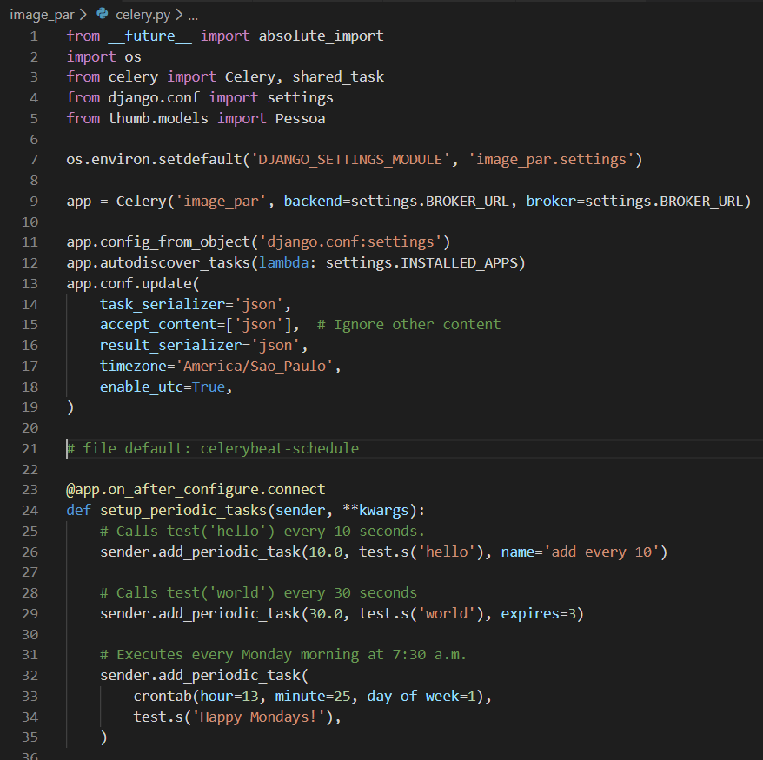

Slide 7
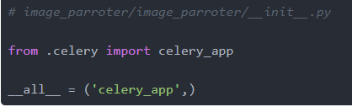
7. File __init__.py
8. Create tasks

Slide 8
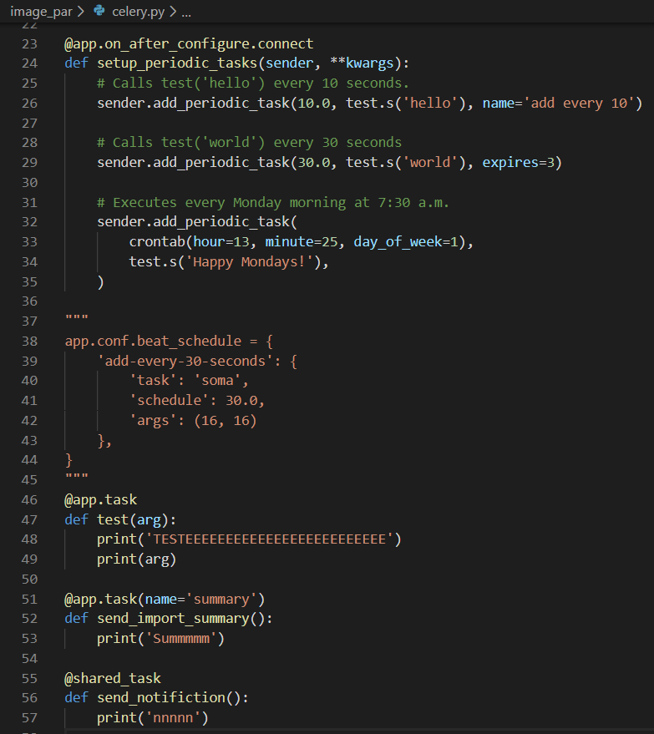

Slide 9
9. When it worked, i had only two terminals open. The first was redis server, and the other:
celery worker -A image_par --pool=solo --loglevel=info
------- And now, the next steps are for periodic tasks -------------------
Documentation:
https://docs.celeryproject.org/en/latest/userguide/periodic-tasks.html

Slide 10
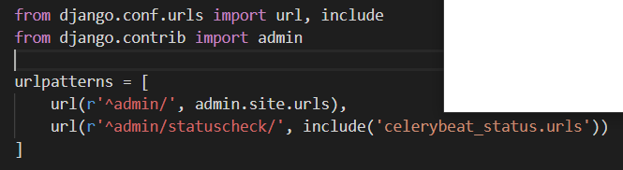
pip install django-celery-beat
pip install celerybeat_status (optional)
2. Add new apps to INSTALLED_APPS
3. python manage.py migrate
4. However, before it worked, i used another terminal with the command:
celery -A image_par beat --loglevel=debug --scheduler django_celery_beat.schedulers:DatabaseScheduler
Visit the Django-Admin interface to set up some periodic tasks

Slide 11
No fim, é necessário 3 terminais abertos:
1. REDIS SERVER 2. CELERY WORKER 3. CELERY BEAT
*Import commands: pip freeze > requirements.txt
pip install -r requirements.txt

